Slide 1
Day 1 Session 2

Slide 2
Objectives of Session
Dive into
Data types
Operators
Conditional Statements
Looping constructs
Classes and Objects
Constructors
Methods
Variables
Arrays

Slide 3
Data Types
Data Types- Data type specifies the size and type of values that can be stored in an identifier. The Java language is rich in its data types. Different data types allow you to select the type appropriate to the needs of the application.
Example – different values-
1232
Bhushan
45643.543
G
true

Slide 4
Data Types
In order to achieve this, Java is very well equipped with Data types.
Data Types are broadly divided in two data types in Java.
1. Primitive Data types
2. Non-Primitive Data types.

Slide 5
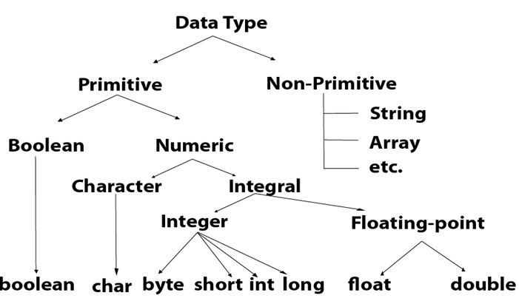
Data Types

Slide 6
Data Types
There are 8 primitive data types in Java.
boolean data type
byte data type
char data type
short data type
int data type
long data type
float data type
double data type

Slide 7
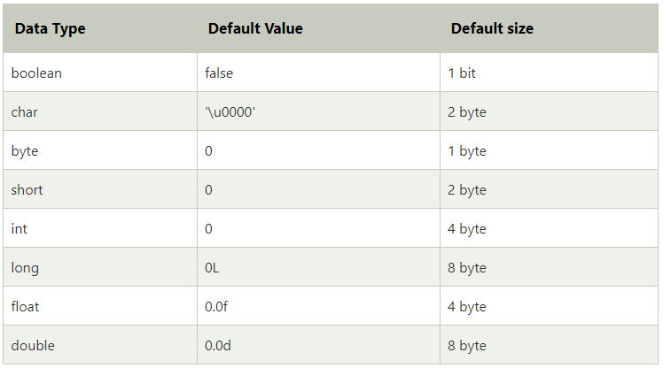
Data Types
Different data type comes with different size in order to save memory.

Slide 8
Data Types
Boolean Data Type
The Boolean data type is used to store only two possible values: true and false.
Byte Data Type
The byte data type is an 8-bit signed two's complement integer. It has a minimum value of -128 and a maximum value of 127 (inclusive).
The byte data type is used to save memory in large arrays where the memory savings is most required.
D1
D2

Slide 9
Data Types
Char Data Type
The char data type is a single 16-bit Unicode character. Its value-range lies between '\u0000' (or 0) to '\uffff' (or 65,535 inclusive).The char data type is used to store characters.
What is ‘\u0000’ t0 ‘\uffff’ ?
Ans- > It is same like [0,65535]
Explanation →
Java Follows Unicode Schemes for Char
Each character encode in binary and save to memory
Java use Unicode scheme for
Character →Unicode → Binary
Binary → Unicode →Character.

Slide 10
Data Types
Char Data Type
Take some examples→
So consider ASCII values of some characters =
‘A’ → ‘\u0041’ →65
‘a’ → ‘\u0061’ →97
‘;’ →’\003b’ → 59
These are hexadecimal numbers.
Let’s try this with demonstration.
D3

Slide 11
Data Types
Short Data Type
The short data type is a 16-bit signed two's complement integer. Its value-range lies between -32,768 to 32,767 (inclusive).
Int Data Type
The int data type is a 32-bit signed two's complement integer. Its value-range lies between - 2,147,483,648 to 2,147,483,647 (inclusive).
Long Data Type
The long data type is a 64-bit two's complement integer. Its value-range lies between -9,223,372,036,854,775,808 to 9,223,372,036,854,775,807(inclusive).
D4
D4
D4

Slide 12
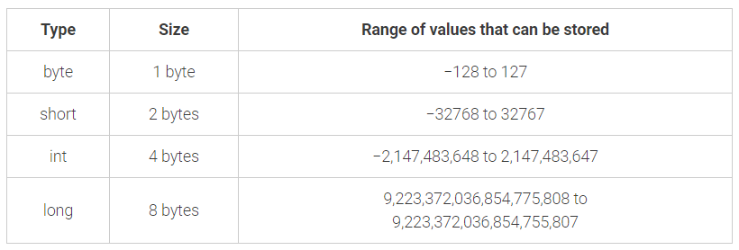
Data Types
D5 with calculator
How does range of data types get calculated?
The range of values is calculated as −(2^{n−1}) to (2^{n−1})−1; where n is the number of bits required. For example, the byte data type requires 1 byte = 8 bits. Therefore, the range of values that can be stored in the byte data type is −(2⁸⁻¹) to (2⁸⁻¹)−1 = −2⁷ to (2⁷) -1 = −128 to 127

Slide 13
Data Types
D6
Floating Data
Floating data type is use to represent number with fractional values.
There are two data types for floating values
float →Stores fractional numbers. Sufficient for storing 6 to 7 decimal digits. Size of float is 4 bytes
double → Stores fractional numbers. Sufficient for storing 15 decimal digits. Size of double is 8 bytes.

Slide 14
Data Types
Non –Primitive Data type
Non-primitive data types are called reference types because they refer to objects.
Class, object, array, string, and interface are called non-primitive data types in Java.
Example –
String class.
Array Class.
Integer.

Slide 15
Data Types
Understand Non primitive Data type with String class.
String is class , when we have to use String data type then it create reference to this class.
String StudentName = “Bhushan”;
(We will see String class in depth because it is very important in Java)
(In Java if you don’t Know String then You don’t have enough understanding of Java.)
D7

Slide 16
Operators in Java
Operators in Java are widely divided into categories.
Unary Operator,
Arithmetic Operator,
Shift Operator,
Relational Operator,
Bitwise Operator,
Logical Operator,
Ternary Operator and
Assignment Operator.

Slide 17
Operators in Java
Java Unary Operator
The Java unary operators require only one operand. Unary operators are used to perform various operations
incrementing/decrementing a value by one
negating an expression
inverting the value of a boolean

Slide 18
Operators in Java
Java Unary Operator
incrementing/decrementing a value by one
Java Unary Operator Example: ++ and --
There are two operations using increment and decrement operators.
Postfix
Prefix
Example = int a=10;
a++;
Output will be 11;
Example ➔ (demonstrate)
int n1=10;
int m=n1++;
System.out.println("n1="+n1+"m="+m);
int k=++m;
System.out.println("n1="+n1+"m="+m+"k"+k);
Output= n1=11m=10
n1=11m=11k11

Slide 19
Operators in Java
D8
Java Unary Operator
Java Unary Operator Example:
negating an expression → ~
Inverting values of boolean → !
int num1 =25;
Int num2 = -30;
boolean res = true;
Sysout(`num1); → -26 ( minus of total positive value which starts from 0)
Sysout(`num2); → 29 (positive of total minus, positive starts from 0)
Sysout(!res); → false

Slide 20
Operators in Java
D9
Java Arithmetic Operators
Java arithmetic operators are used to perform addition, subtraction, multiplication, and division. They act as basic mathematical operations.
+ → use to perform addition
- → use to perform subtraction
* → use to perform multiplication
/ → use to perform division
% → use to perform modulo.
(We can perform expression operation, Ex → perform various operation in one expression.
But it follows sequence → * / % + -)

Slide 21
Operators in Java
D10
Java Assignment Operators
Java assignment operator is one of the most common operators. It is used to assign the value on its right to the operand on its left.
int num1=20;
int num2=30;
a+=4;//a=a+4 (a=20+4)
b-=4;//b=b-4 (b=30-4)
System.out.println(a);
System.out.println(b);

Slide 22
Operators in Java
Java Logical Operators
Following are the logical operator in Java
logical AND → It represent by && operator
(It checks conditions if first is true then it will check second and if both true result will be true)
logical OR → It represented by || operator
(It checks conditions if first is false then it will check second and if any one is true result will be true)
Java Bitwise Operator
Bitwise AND → It represent by & operator
(It checks both conditions even if first condition false)
Bitwise OR → It represent by | operator
(It checks both conditions even if first condition true)
D11
D12

Slide 23
Operators in Java
D13
Java Ternary Operators
Java Ternary operator is used as one line replacement for if-then-else statement and used a lot in Java programming. It is the only conditional operator which takes three operands.
int num1=24;
int num2=54;
int min=(a<b)?a:b; output → 24

Slide 24
Conclusion
In this session we have learned Data types and Operators.

